Slide 1
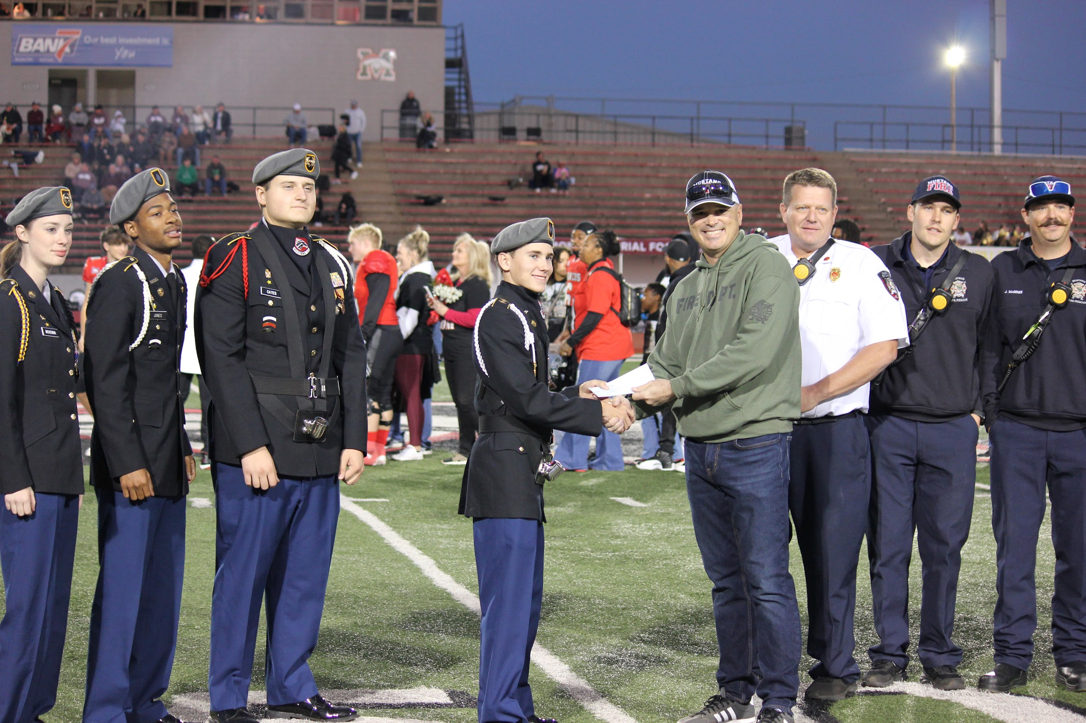
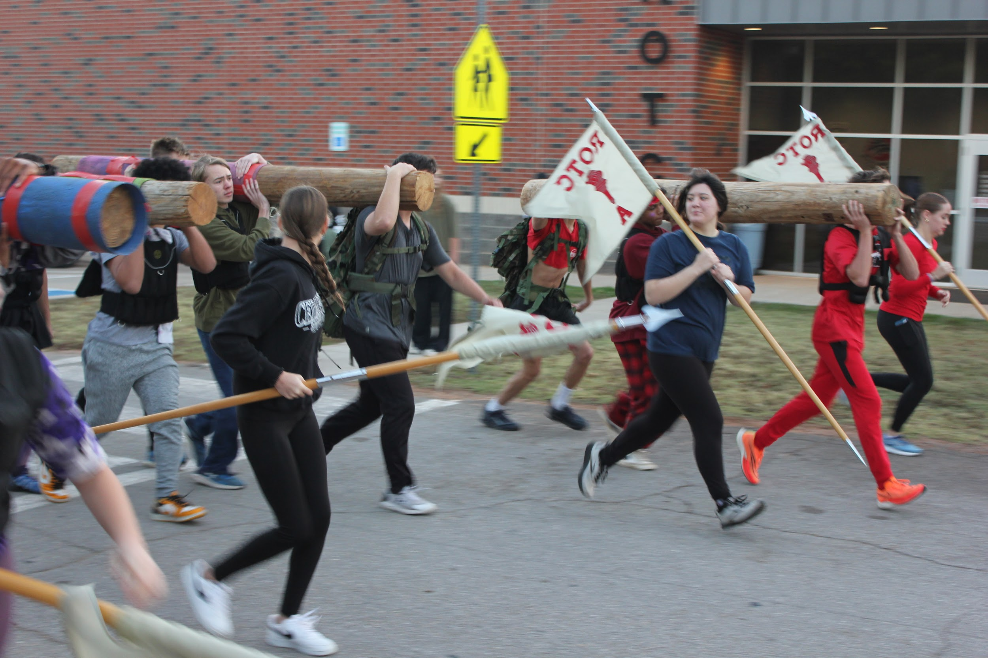
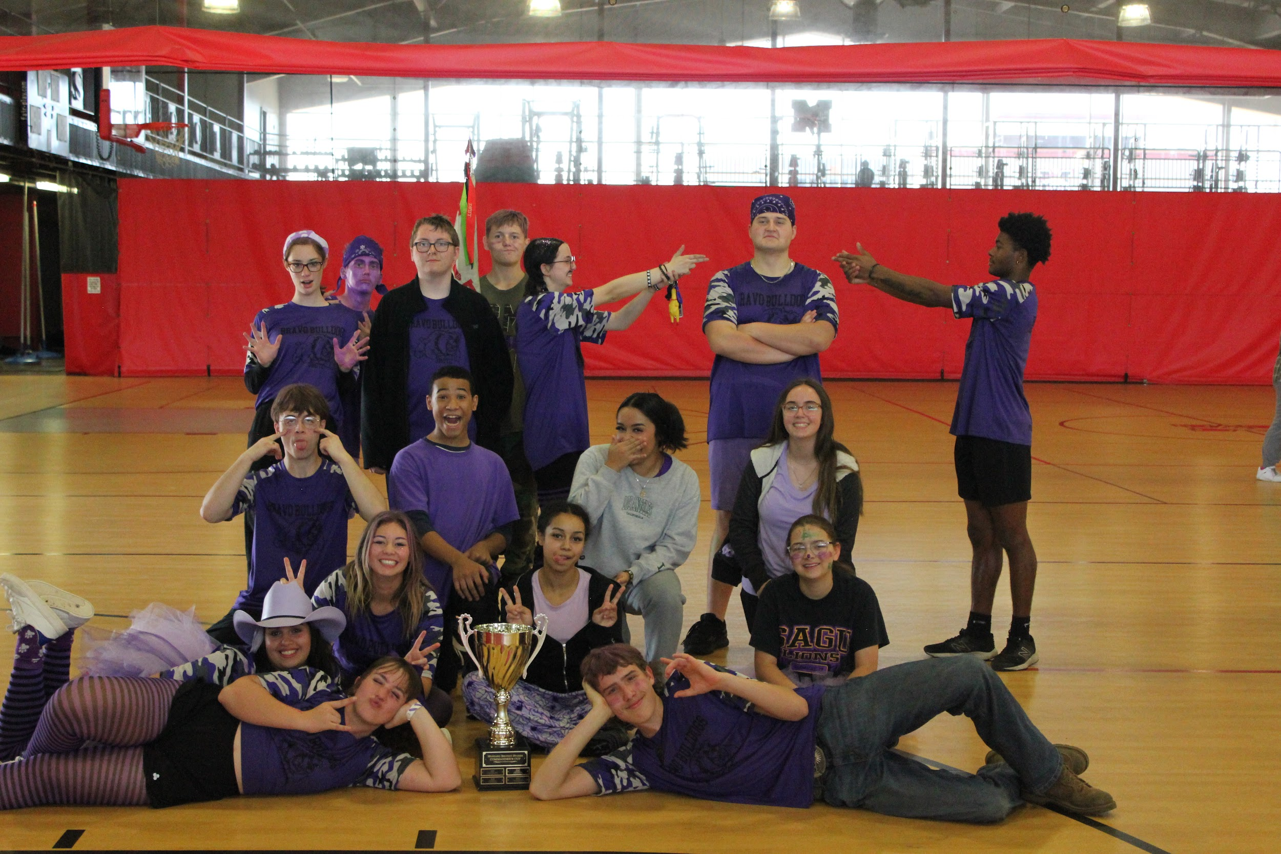
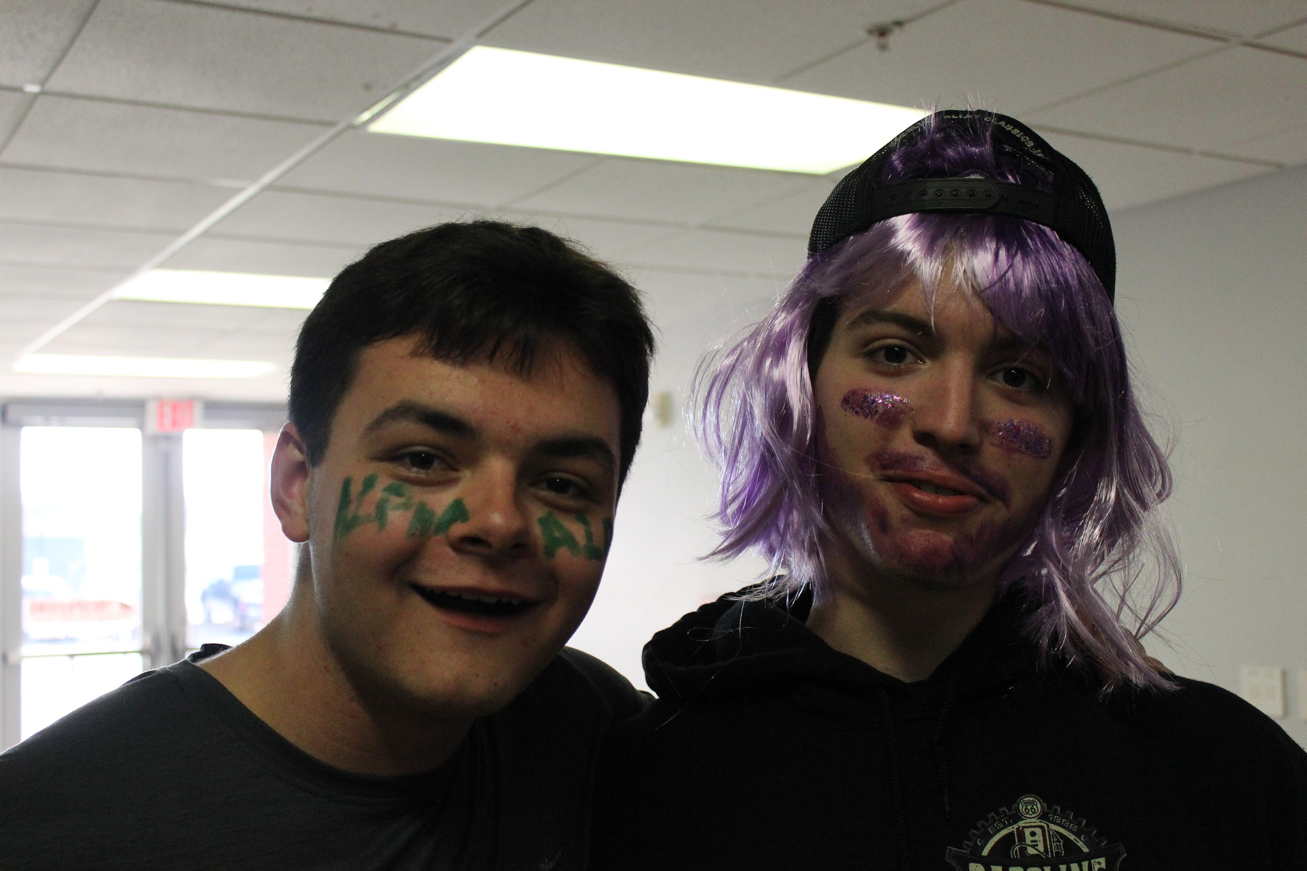
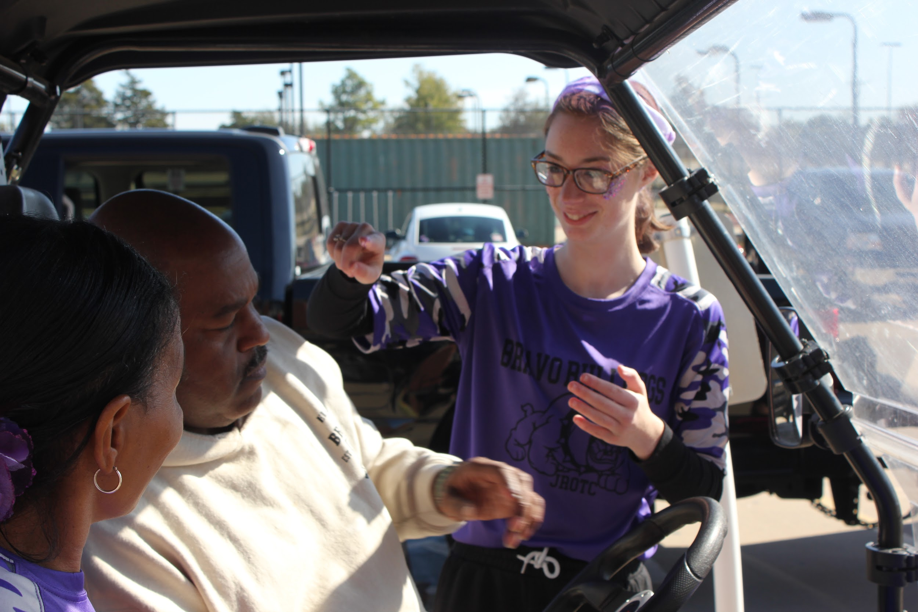
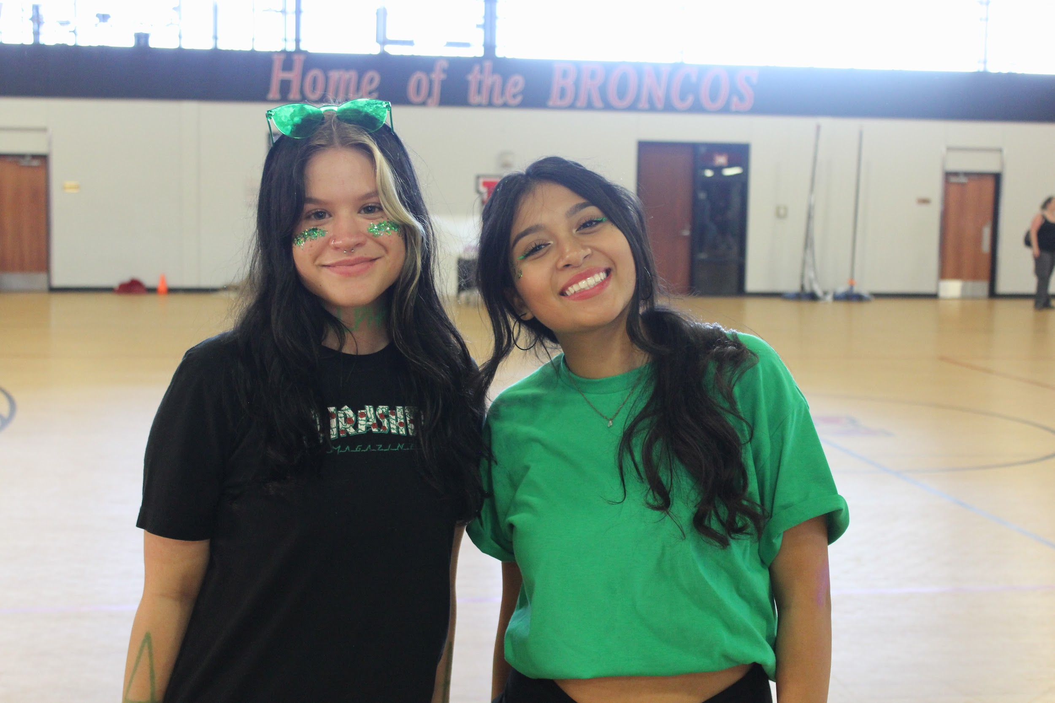
NOV 2023 Newsletter 23-02
The Bronco Battalion is Thankful
Broncos Get Ready for More Events
Bronco Stakes
Bronco Stakes 2023 is in the books. Thank you to all the cadets that showed up and the booster club and other parents that made this all possible. Congrats to Bravo company on winning. Everyone did amazing and we can’t wait to do it again next year.
Thank you to Mustang Fire Department for supporting our battalion. We are forever grateful for your donation. With this dotation we are able to many more things this year. We are going to be bringing back Wreaths Across America in part of this donation
Even though we have had many events already, it would not be a very good school year if we had nothing to do. Upcoming is Veterans Day Color Guard, Drill Competitions, Thunder Game Color Guard and much, much, more. With all these events The Battalion staff asks that anyone that can help out so we can continue to do these events
Bronco Battalion Prepares for Competition
Last month we had a competition in Texas. This month on the 18th we will be back in Texas at Wichita Falls so we can take the top again. The cadets on each team have prepared all month for this. Let’s show up and support our cadets
(Above:Bravo Company with the Bronco States trophy)

Slide 2
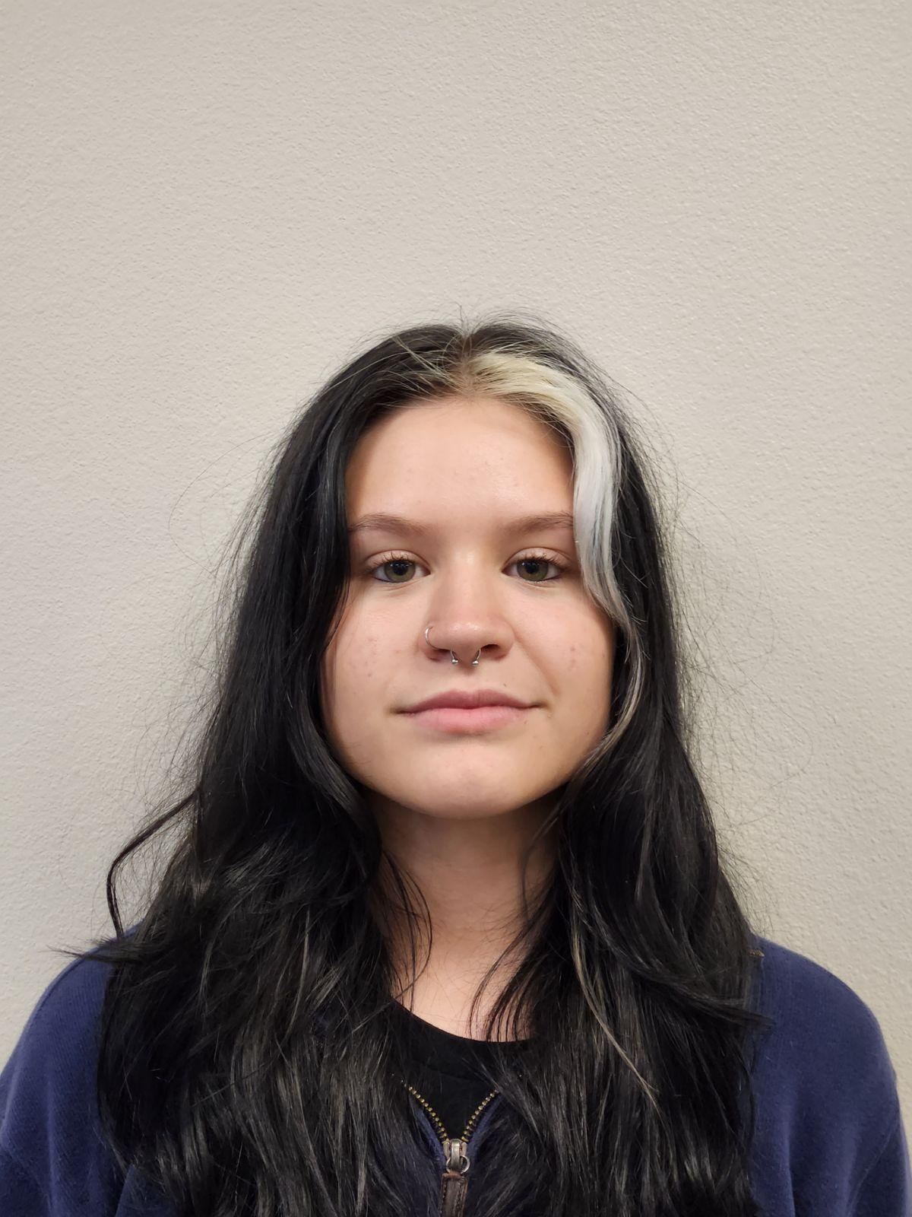
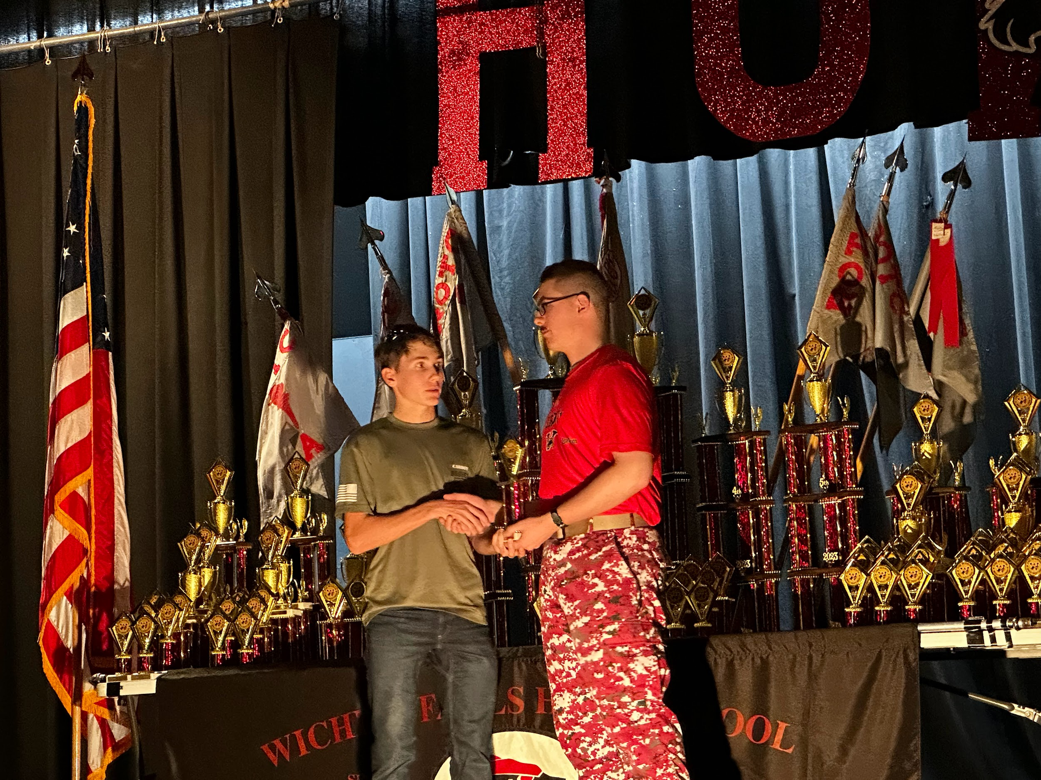
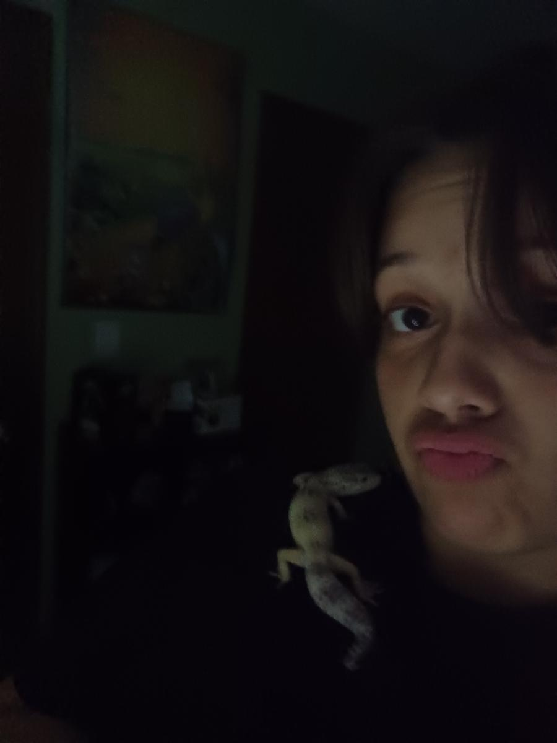
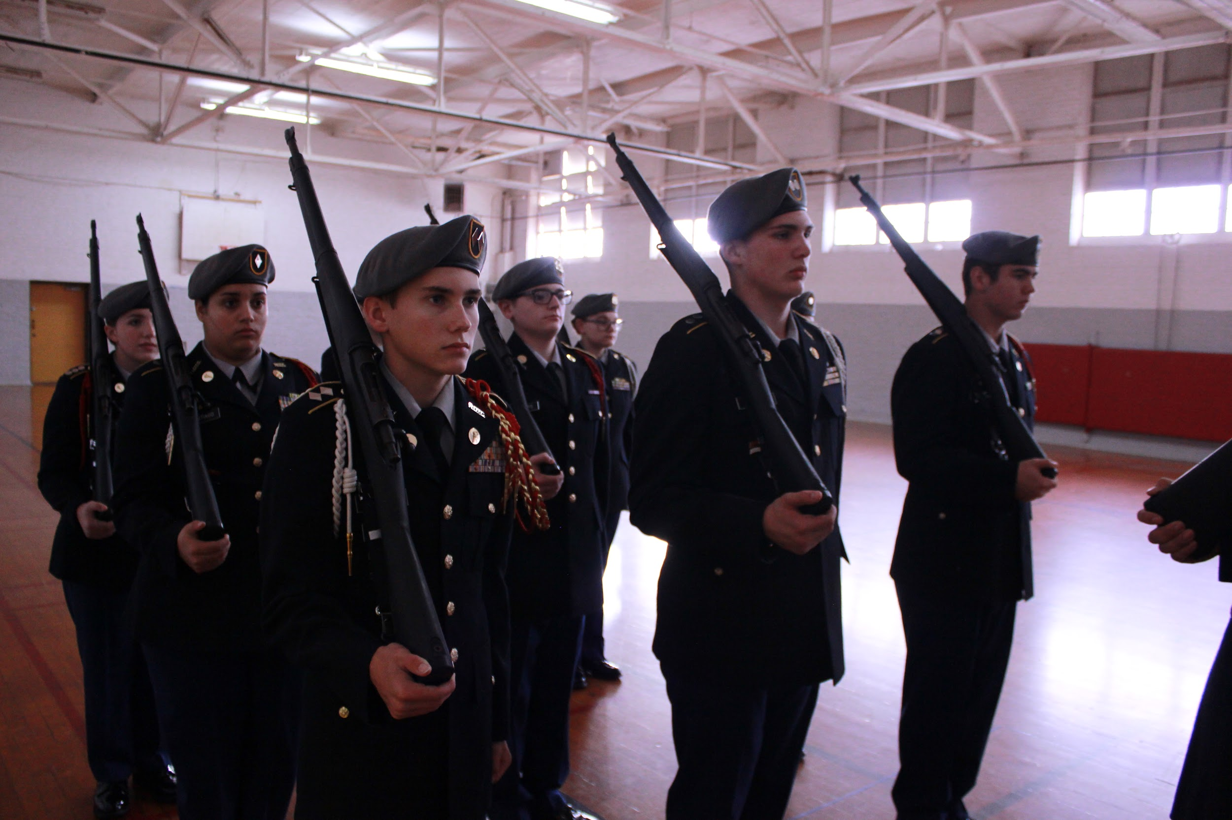
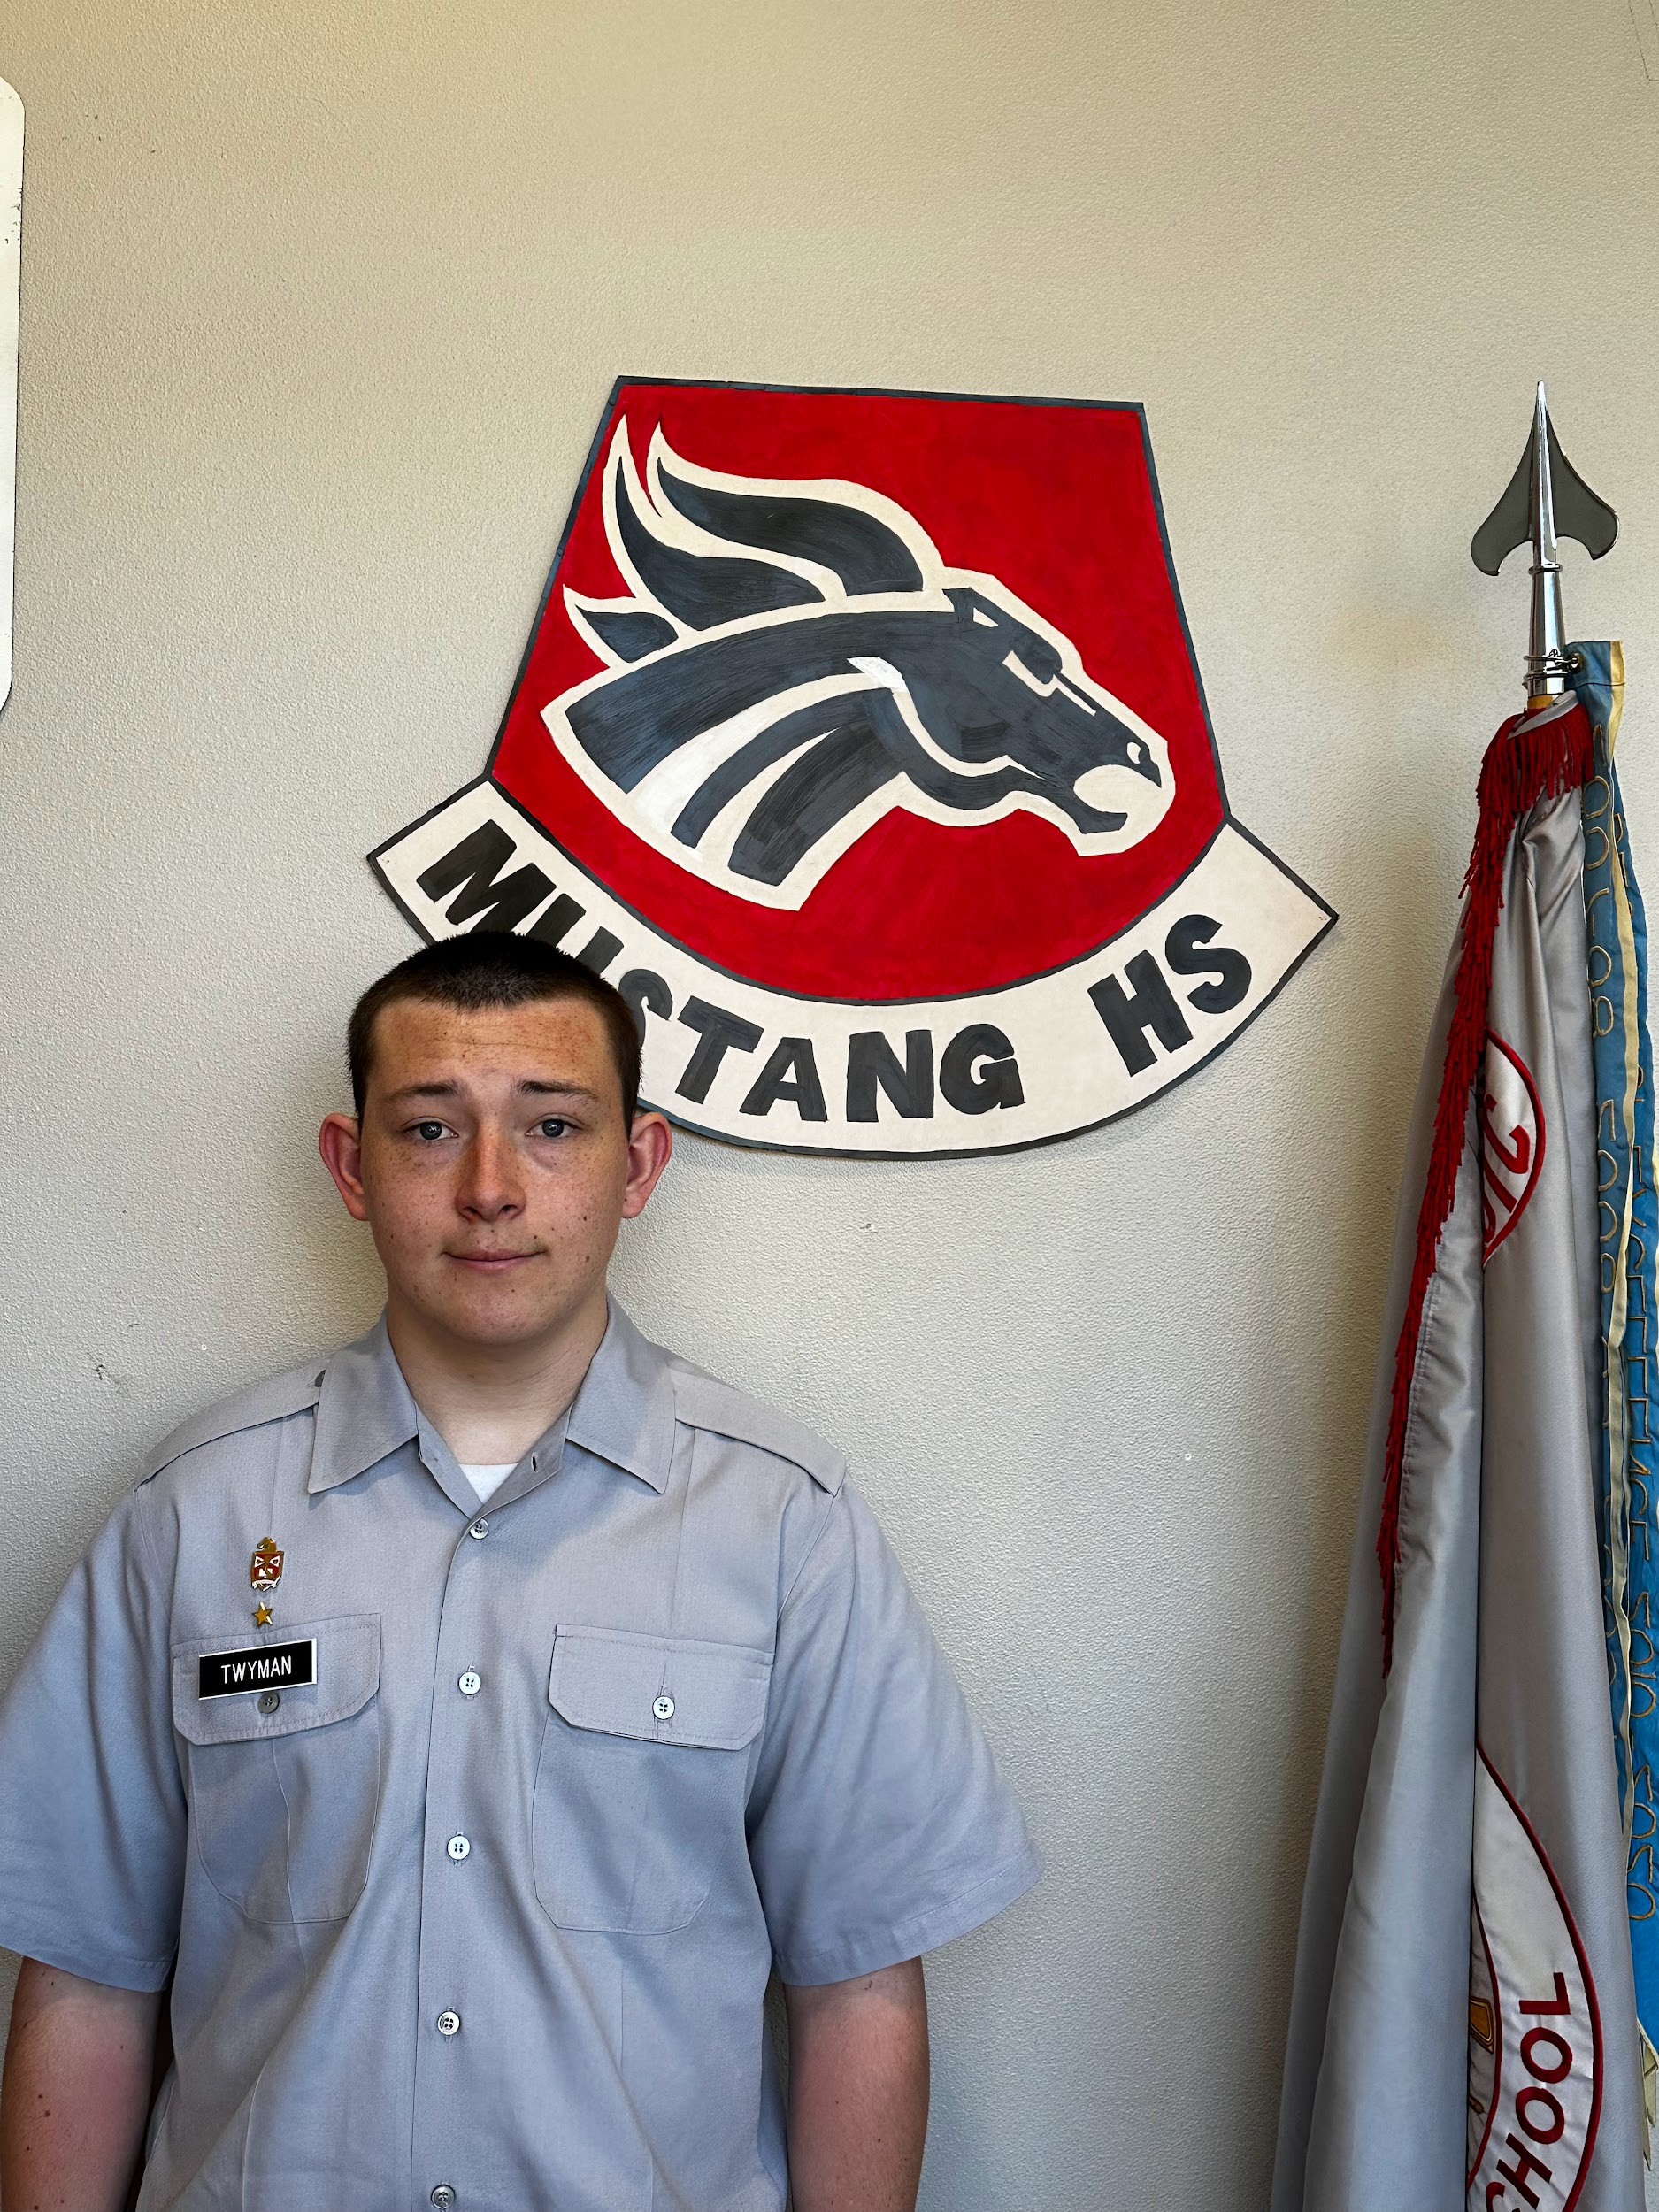
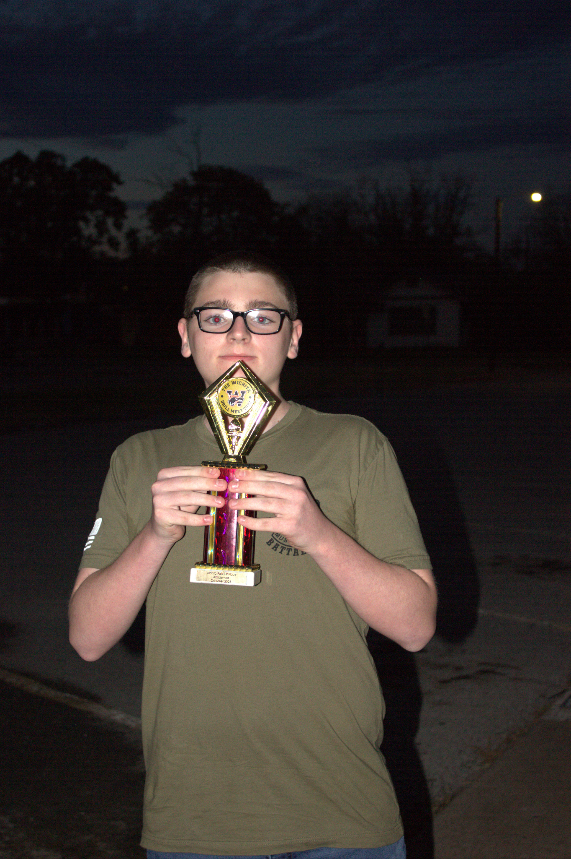
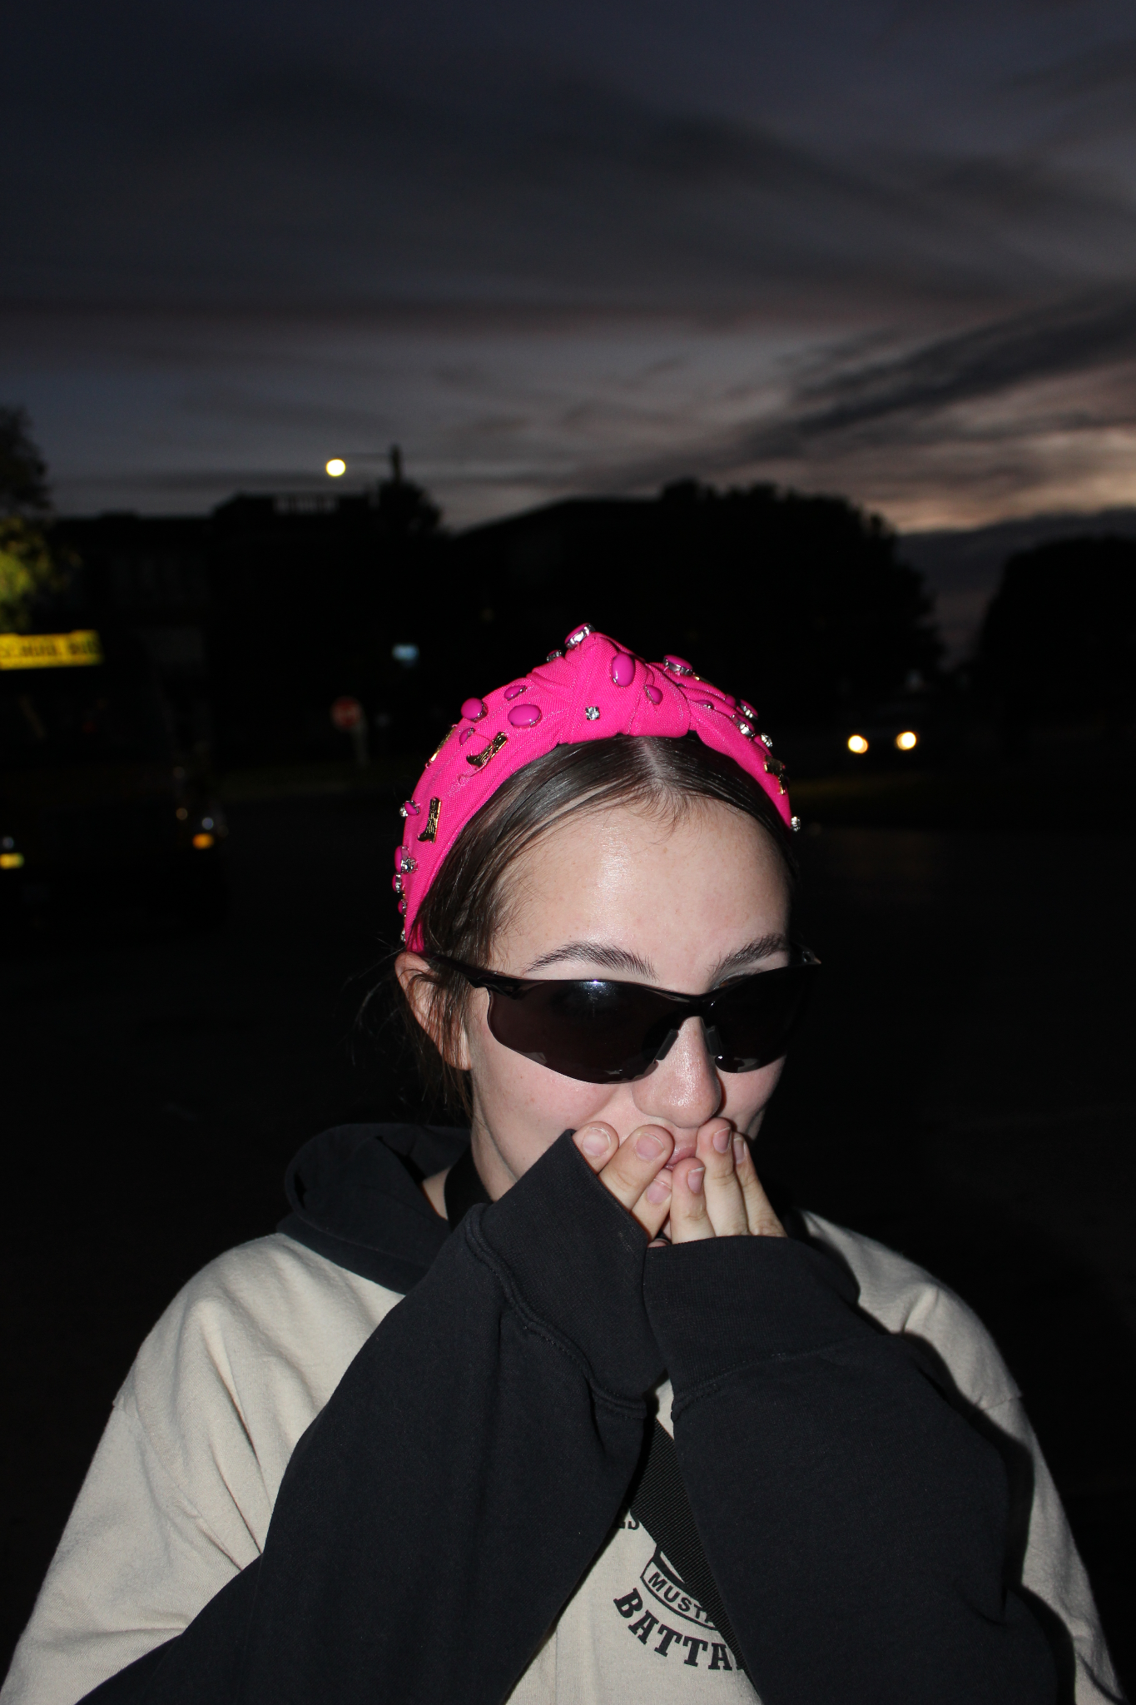
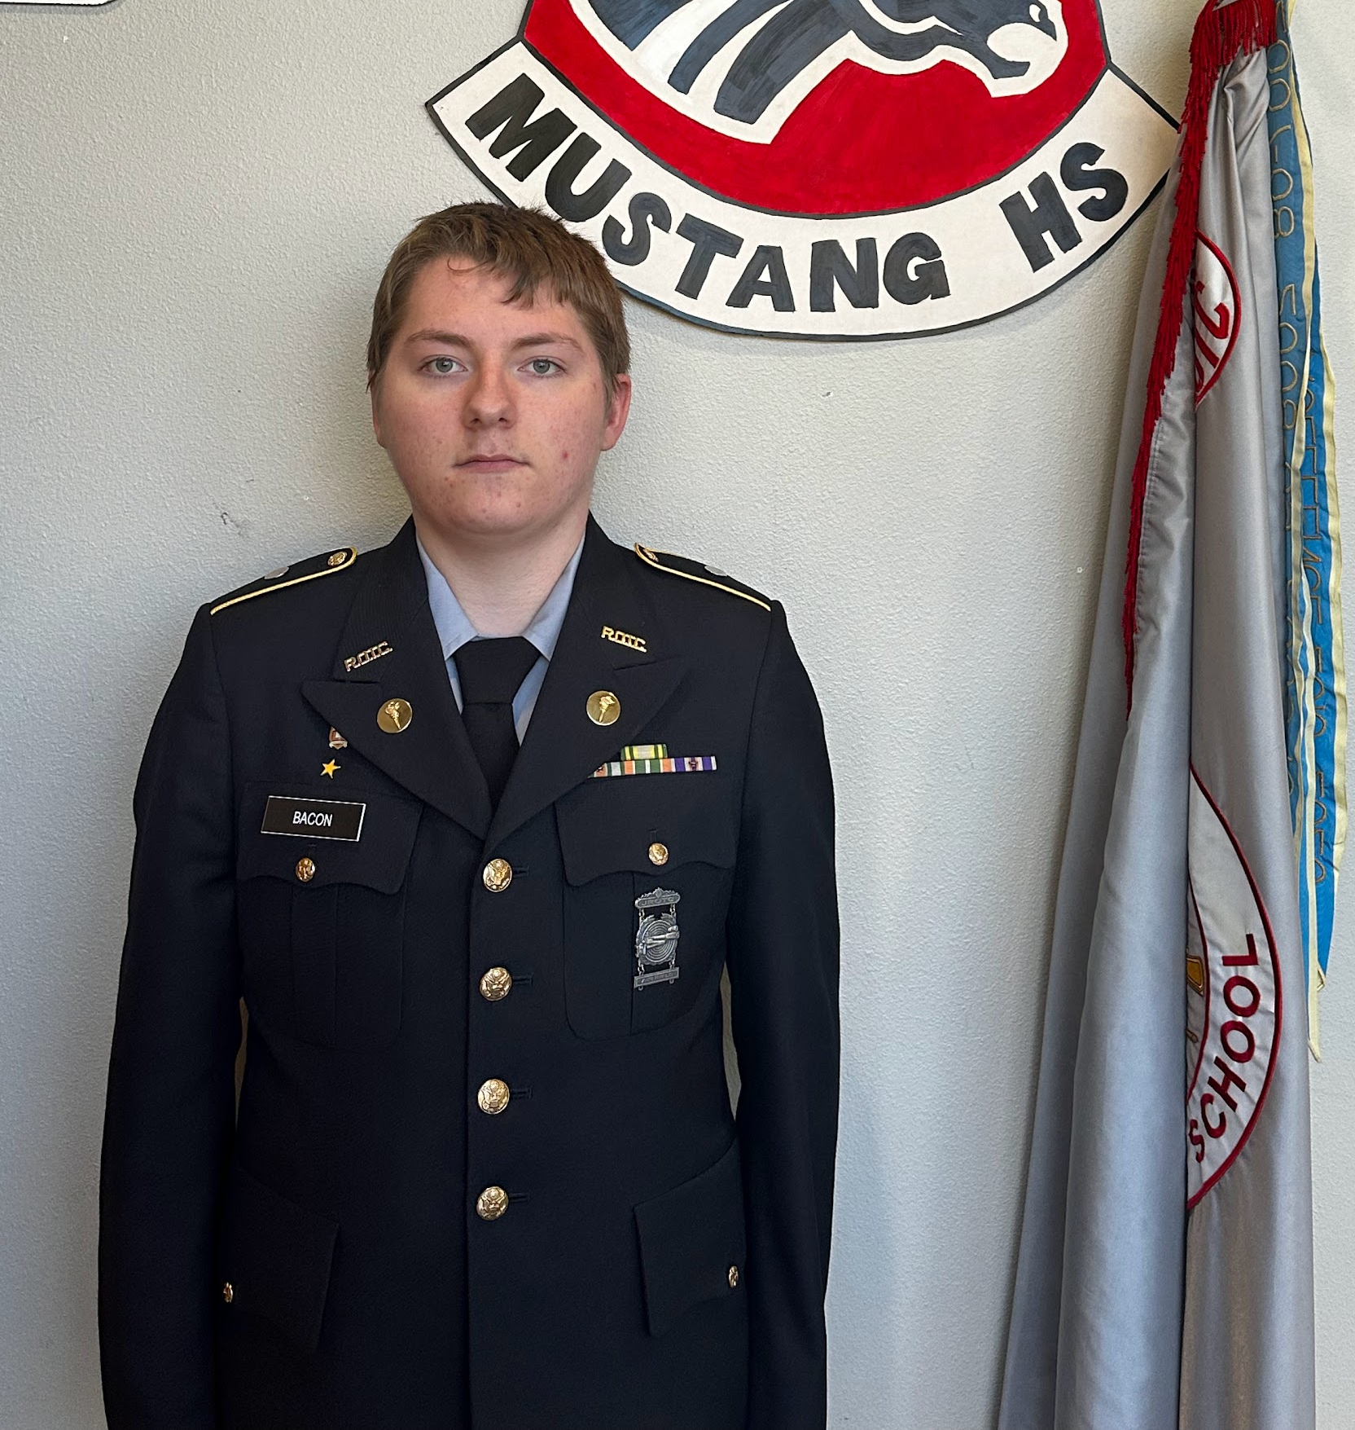
NOV 2023 Newsletter 23-02
Reminders
Cadet Interviews
Wichita Falls Drill Meet
LET-2: Lyon, D
“I'm in JROTC because it provides opportunities for personal growth and leadership development. It teaches me valuable life skills like discipline, teamwork, and effective communication”
LET-3: Cranford, A
“I am in JROTC because I was trying to find something that interested me in high school in my freshman year. Being in JROTC will help me determine what I want to do for my future so I am sticking with it.”
LET-4:Bacon, A
“I have involvement with other junior military programs prior to highschool and wanted to continue that until I graduated, aiming to join the military in some capacity after.”
Please remember when you wear the uniform you are representing the battalion.
There are drill meets and sports that our cadets practice hard for so come out and support them.
Keep the building clean
Overall we came home with many awards. This was a major improvement from Top of Texas. Our next drill meet will be the Carl Albert Dirty Dozen on 2 December. We would love the support of fellow cadets. In Wichita Falls Drill, Color Guard, and Raiders teams all competed.
Cadet Interviews
Question: Why did you choose to be in JROTC?
LET- 1: Twyman, W
“I joined JROTC to better my ability to perform customs and courtesies in a program called thes Civil Air Patrol.”

